Slide 1

Customer Segmentation based on purchasing behavior
Melvin Biju (1631027)
MSC SOFTWARE SYSTEMS (X SEM)
DEPARTMENT OF COMPUTING
GUIDED BY
Dr. C SATHYA

Slide 2
TOPICS TO BE DISCUSSED
PROPOSED SYSTEM
SCOPE
DATASET SCHEMA
FEATURE IDENTIFICATION
ANALYSIS USING RFM
RFM TABLE
FINDING CLUSTERS BY K- Means
NORMALIZING AND HANDLING UNDESIRED VALUES
INFERENCES AND CONCLUSIONS

Slide 3
PROPOSED SYSTEM
In order to see how value is generated in a segment and how a company can adapt its marketing and sales activities according to that knowledge, we have used the MRL retail customer transaction data.
To find out how value is generated for customers in this segment, we have used a theoretical framework (RFM) consisting of customer-perceived value and its influences on buying behavior.
This understanding can be used to create segment specific marketing and sales strategies and as a result become customer focused.

Slide 4
SCOPE
Isolate the most valuable customers of the company
Identify the kinds of customers the company have
This can be used for targeted marketing and other marketing strategies.
Sometimes it can even reveal a potential white space in the marketplace which no company has yet occupied.

Slide 5
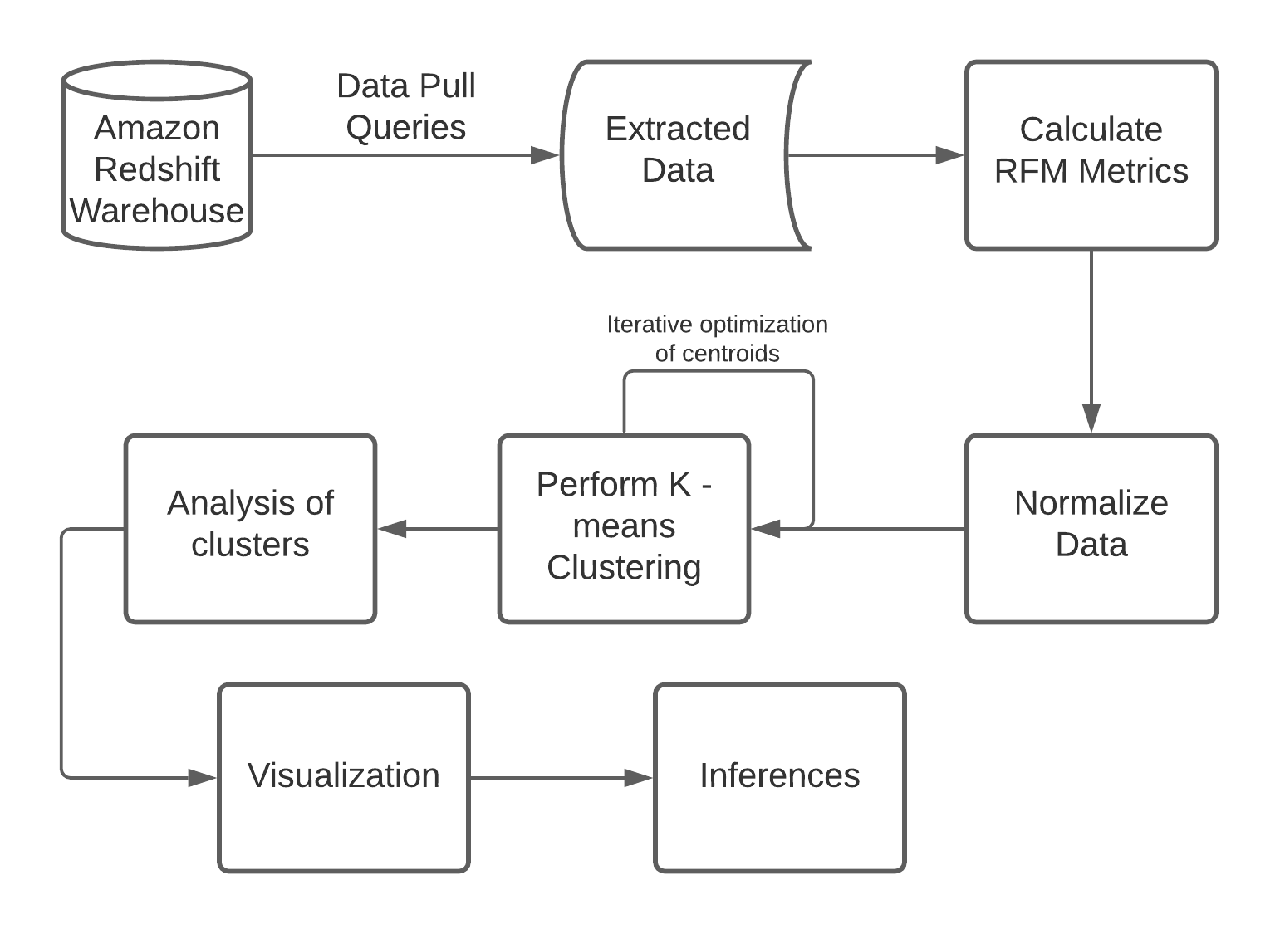
Process - Flow Diagram

Slide 6
Tools used:
Jupyter Notebook (Python)
Microsoft Excel VBA
R studio

Slide 7
Libraries used:
Pandas
NumPy
Matplotlib
Seaborn
Sklearn
dplyr

Slide 8
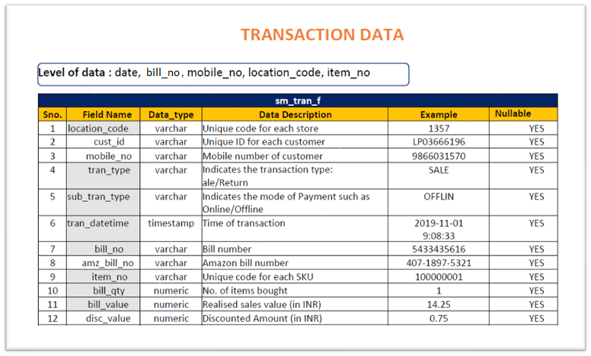
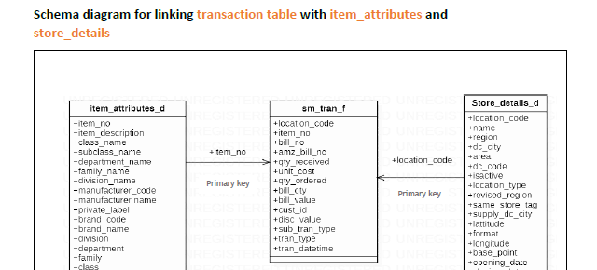
Dataset Schema

Slide 9
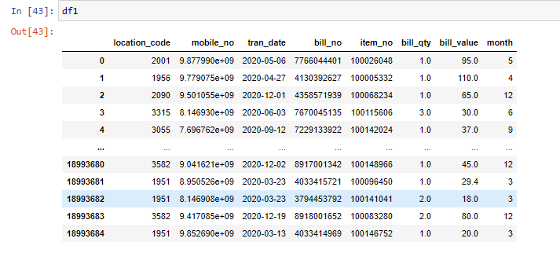
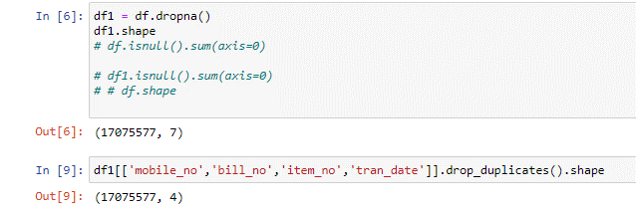
Feature Identification

Slide 10
RFM Model
What is RFM Analysis?
Recency, frequency, monetary value (RFM) is a marketing analysis tool used to identify a firm's best clients, based on the nature of their spending habits.
RFM analysis helps firms reasonably predict which customers are more likely to make purchases again in the future, how much revenue comes from new (versus repeat customers) etc.

Slide 11
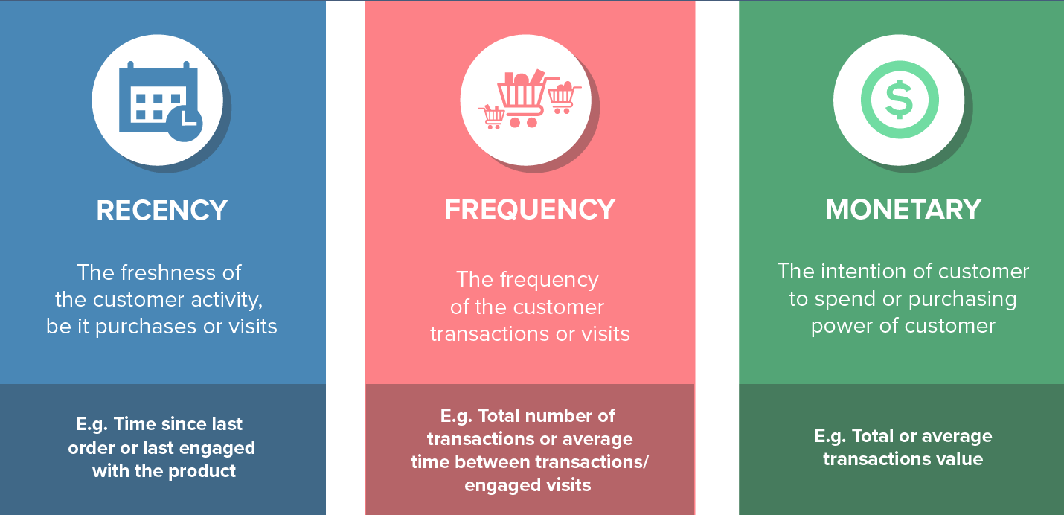
RFM Metrics

Slide 12
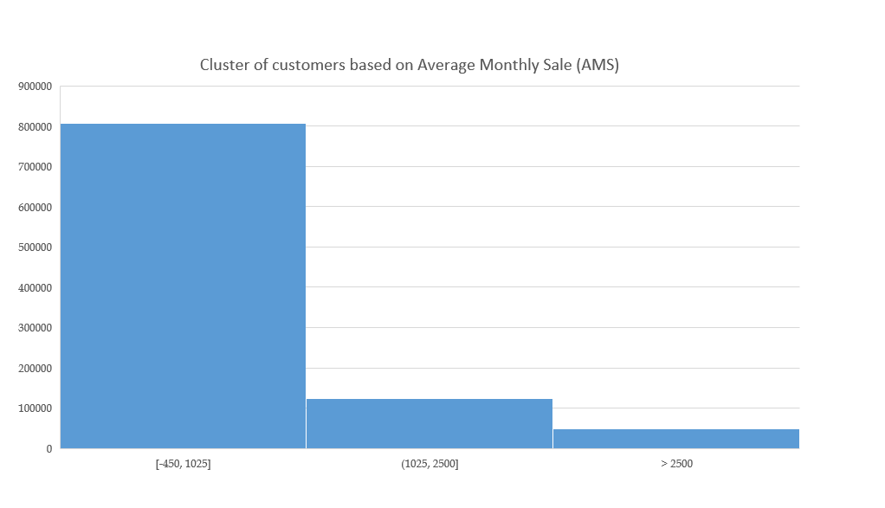
Monetary Analysis (M Value)
Customers are split into 3 clusters
Cluster 1 – Shops for less than 1000rs (Mostly Bachelors, small shoppers)
Cluster 2 – Shops between 1000rs and 2500rs.(Mostly nuclear families or couples)
Cluster 3 – Shops above 2500rs.(Can be joint families or retailers).
Observation
Three distinct clusters are found based on the Average Monthly Sales (AMS).

Slide 13
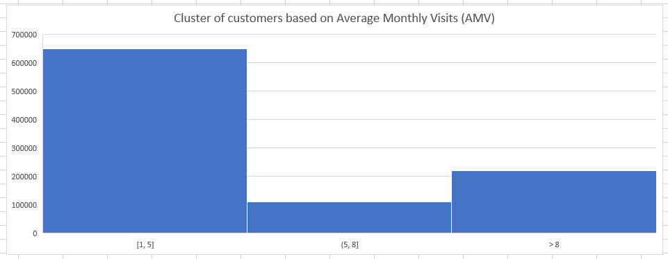
Frequency Analysis (F Value)
Customers are split into 3 clusters
Cluster 1 – Shops at most once a week
Cluster 2 –Shops at most twice a week
Cluster 3 – Shops multiple times and are high value customers.
Observation
Three distinct clusters are found based on the Average Monthly Visits (AMV).

Slide 14
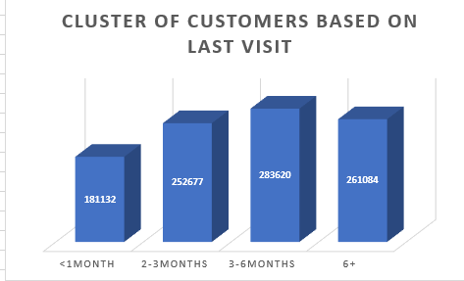
Recency Analysis (R Value)
Customers are split into 4 clusters:
Cluster 1 – Recent visit is less than a month.
Cluster 2 – Last visit was about 2-3 months ago.
Cluster 3 – Last visit was about 3-6 months ago.
Cluster 4 – Haven't visited the store in a long time
Observation
Four distinct clusters are found based on Recency.

Slide 15
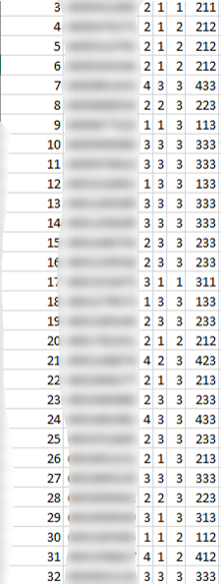
RFM Table
Recency (R score)
1 – Customer who visited within a month
2 – Customer who visited in the past 2 – 3 months
Frequency (F score)
1 – who visits more than twice a week.
2 – who visits once or twice a week
3 – atmost a week
Monetary (M score)
1 – Spends more (Joint family, High income customers, Retailers)
3 – Customer who visited in the past 4- 6 months
4 – Customer who didn't turn up for the past six months
2 – Spends average (Average income customers, Nuclear family)
3- Spends less (Bachelors, low-income customers)

Slide 16
FINDING CLUSTERS
K- Means Clustering
Clustering is one of the most common exploratory data analysis technique used to get an intuition about the structure of the data.
It can be defined as the task of identifying subgroups in the data such that data points in the same subgroup (cluster) are very similar while data points in different clusters are very different.
K-means algorithm is an iterative algorithm that tries to partition the dataset into K pre-defined distinct non-overlapping subgroups (clusters) where each data point belongs to only one group.

Slide 17
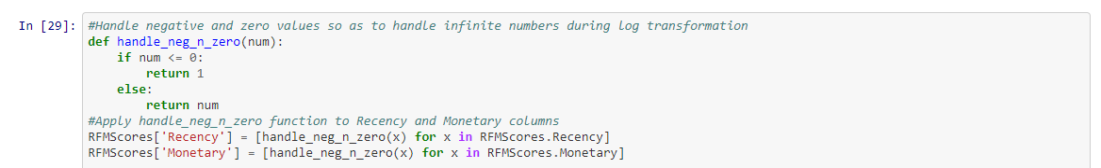
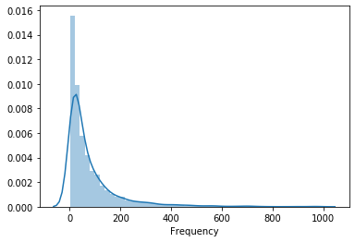
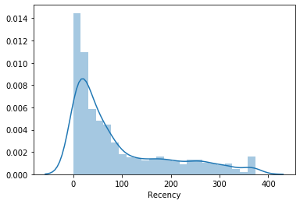
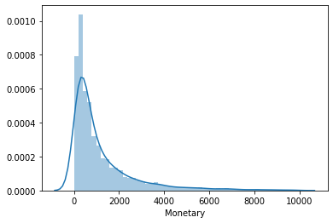
Handling Negative and Zero values

Slide 18
STATISTICAL NORMALIZATION
Methods used:
Log transformation ( to remove Skewness)
Shapiro–Wilk test for normality

Slide 19

Shapiro- Wilk Test
The Shapiro–Wilk test tests the null hypothesis that a sample x1, ..., xn came from a normally distributed population. The test statistic is W
The test rejects the hypothesis of normality when the p-value is less than 0.05.
Failing the normality test allows you to state with 95% confidence the data does not fit the normal distribution.
Passing the normality test only allows you to state no significant departure from normality was found.

Slide 20
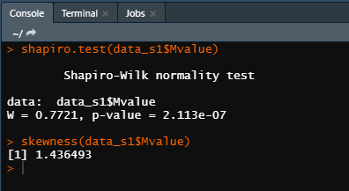
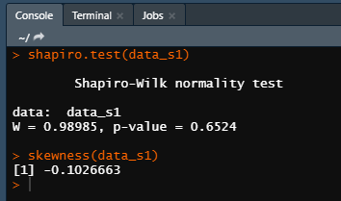
Check for skewness and normality

Slide 21
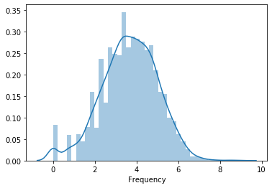
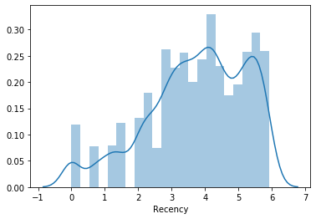
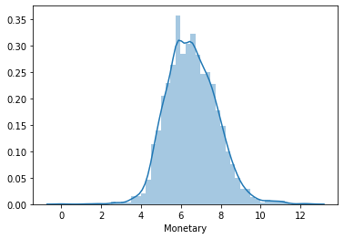
Visualization of the normalized data

Slide 22
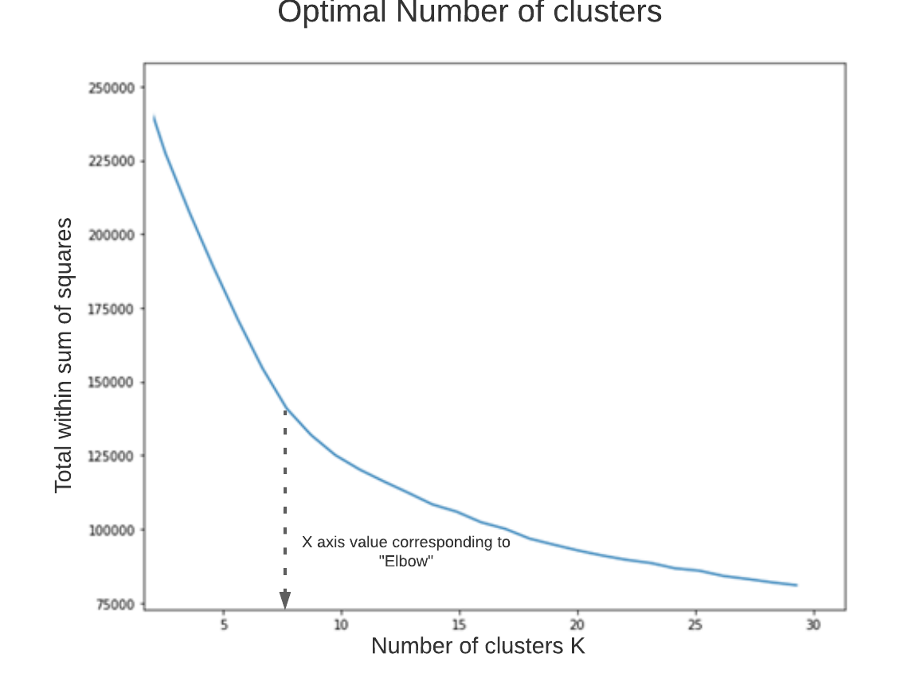
Elbow Method
The elbow method runs k-means clustering on the dataset for a range of values for k (here from 1-30) and then for each value of k computes an average score for all clusters.
To determine the optimal number of clusters, we must select the value of k at the “elbow” i.e., the point after which the distortion/inertia start decreasing in a linear fashion.
Thus, for the given data, we conclude that the optimal number of clusters for the data is 7.

Slide 23
Naming Clusters
Segment | Definition
Best Customers | Most valuable customers who shop frequently with high spending. (111)
Loyal Customers | Customers who shop frequently with low-to average spending. (X1X)
High Spending | Customers who are not that frequent but spend high. (XX1)
Newbies | Recent customers who visited the store(14X)
Slipping Customers | Customers that churned and on the verge of losing. (43X)
Promising Customers | Customers who purchase often but don't spend a lot(X13,X14)
Lost Customers | Once a valuable customers who hasn’t purchased for a long time(433)

Slide 24
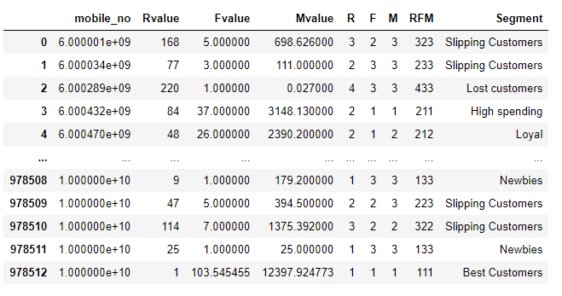
Assign Clusters based on RFM scores
Recency (R score)
1 – Customer who visited within a month
2 – Customer who visited in the past 2 – 3 months
Frequency (F score)
1 – who visits more than twice a week.
2 – who visits once or twice a week
3 – atmost a week
Monetary (M score)
1 – Spends more (Joint family, High income, Retailers)
3 – Customer who visited in the past 4- 6 months
4 – Customer who didn't turn up for the past six months
2 – Spends average (Nuclear family, Couples, average income)
3- Spends less (Bachelors, Low income)

Slide 25
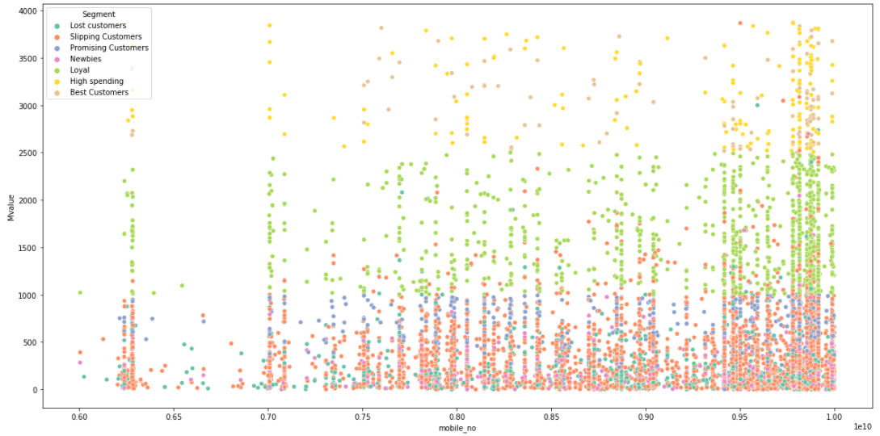
Visualize Clusters – M value

Slide 26
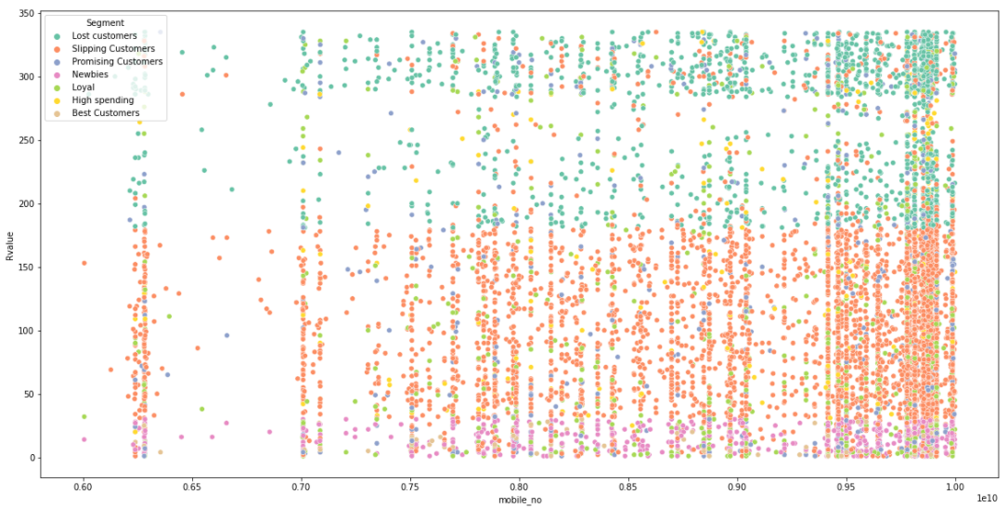
Visualize Clusters – R value

Slide 27
Conclusions and Inferences
Customer segmentation model allows for the effective allocation of marketing resources and the maximization of cross- and up-selling opportunities
Customer segmentation can also improve customer service and assist in customer loyalty and retention.
As a by-product of its personalized nature, marketing materials sent out using customer segmentation tend to be more valued and appreciated by the customer
Companies will stay a step ahead of competitors in specific sections of the market and identify new products that exist, or potential customers could be interested in or improving products to meet customer expectations.

Slide 28
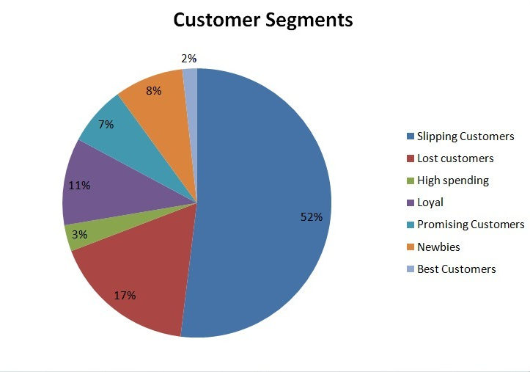
Inferences
This pie chart gives us the percentage of customers in each segment
The large number of slipping customers can be due to the Covid 19 pandemic
3% of the total customers are identified as high spenders and contribute to significant revenue individually.
11% of the total customers are classified as loyal having good RFM scores
8% are identified as new customers and have a possibility to churn if not targeted.
2% accounts for the best customers who have perfect RFM scores of 111.

Slide 29
Sample Strategy
Best Customers: Value added offers along with personalized product recommendations.
Newbies: Welcome emails with introductory offers.
Promising Customers: Product recommendations based on past purchases.
Loyal: Membership benefits.
High Spending: Recommend the best and expensive products.
Lost Customers: "We miss you" e-mails along with information about new products
Slipping Customers: Retention strategies to increase customer engagement e.g., live events.

Slide 30
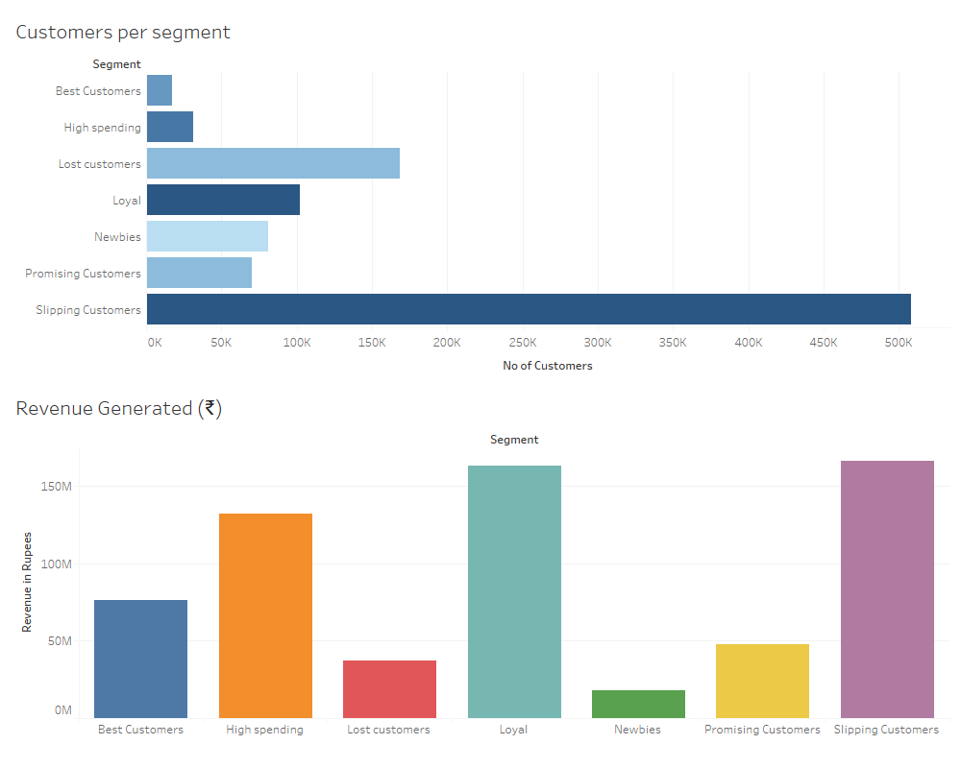
Reports

Slide 31
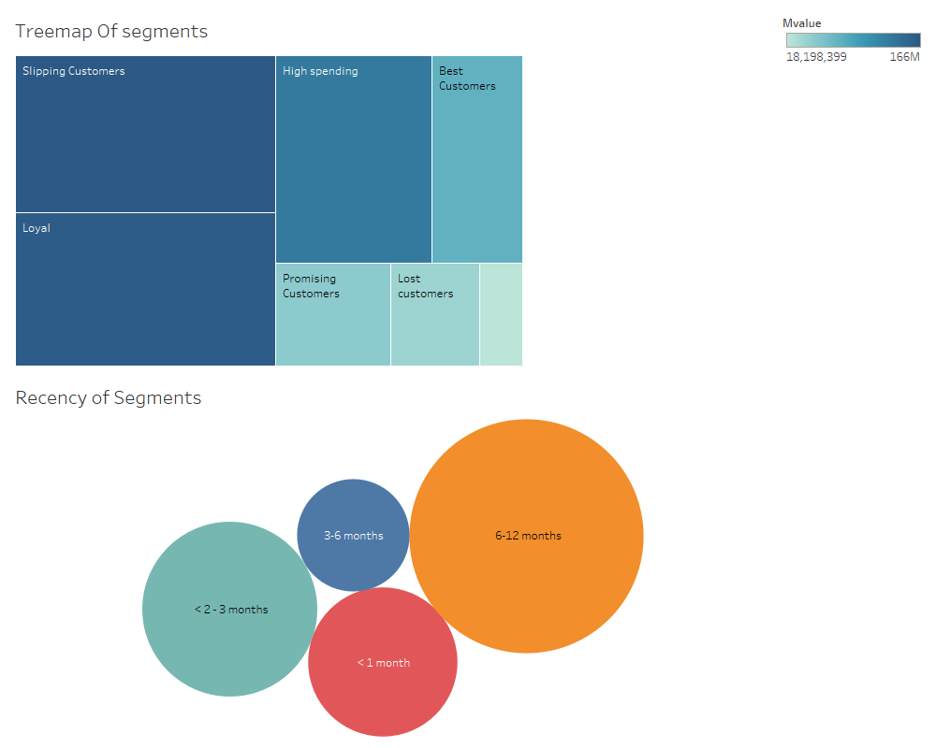
Reports

Slide 32
THANK YOU

